Slide 1


VRJ Solutions
Digitalising Business Processes
Notes:
Good afternoon and welcome to our presentation. This is VRJ solutions an e-Retail company run by Vivienne Estopey, Ritah Nyakato and Joel Geisser. Our objective is to leverage digital technologies to improve the ecommerce department of our business.

Slide 2

About Us
Etc.
Computers
Smartwatches
Home appliances
Mobile phones
Electronics products
Mid-sized company
Who are we?
Notes:
VRJ Solutions is a retail company specializing in electronic products and we provide a wide range of products such as mobile phones, home appliances, smartwatches, computers, among others.

Slide 3
Challenges faced at VRJ Solutions
Internal
Manual processes
External
Unforeseen challenges - Corona
Old fashioned and slow systems
Growing demand for ecommerce
Declining sales in the offline business
Competition from online businesses
Notes:
In the recent years we have been facing some challenges that affected several parts of the business, hence resulting in poor performance. We have analysed the challenges and grouped them into internal and external . From the internal side the challenges include
1. Declining sales in offline business – Now that many customers can shop from their mobile phones or computers, there are less people coming to the store which has affected our sales
2. There are many manual processes which consume a lot of time that could be invested in other activities
3. Currently our systems are old fashioned and slow which again costs us a lot of money and time.
From the external point of view,
1. There is a growing demand for an ecommerce platform. Customers are increasingly demanding for an online platform so that they may shop whenever they want in the comfort of their homes
2. Competition especially from existing online business is growing – the number of online electronics stores has been increasing and because we are still an offline company, we are not able to retain our customers
3. The current business environment is changing dramatically and there are unforeseen changes in the environment. For instance, the recent outbreak of CODID-19 has increased the need to accelerate development and digitalization solutions.

Slide 4

Solution
Notes:
To address these challenges and be efficient, we have made the decision to transform the offline store to online store with improves process. We ran a proof of concept to explore the possibilities of the online solution. We learned that we still had several manual processes, which cost us time and money. We have therefore made changes by digitalizing the processes.

Slide 5
Main Business Process Changes
Smart inventory system
Automate user tasks
New DWH
Outsourcing shipping

Slide 6
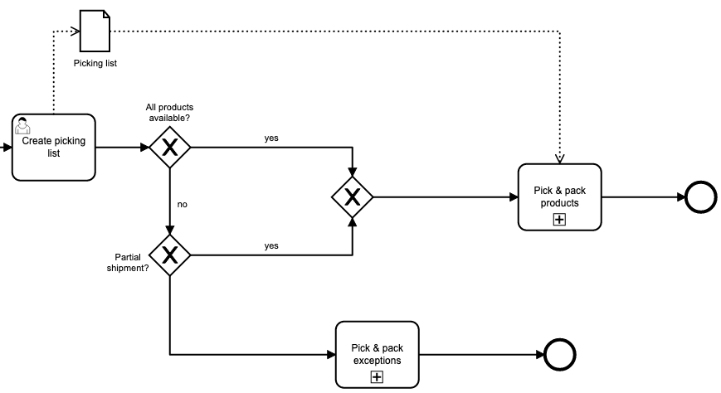
Smart Inventory System
Connected to the ERP and eCommerce system it automatically tracks and updates inventory on the two systems
Alerts employees when stock units are low and need to be replenished
Cuts out the process of having to check if all items are in stock for a particular order
Notes:
The smart inventory system communicates between the ERP and eCommerce systems, meaning if an item is sold out it will change the status from available to sold out on the website.
Furthermore, it will inform employees when stock units are running low and should be replenished, it will generate a prefilled order form for this which just needs to be looked over by a buyer. The prefilled order form which suggests how much to order is based on historic sales data. This should prevent items going out of stock.
The implementation of the smart inventory systenm will therefore, eliminate the lengthy process (shown in the picture on the left) of an employee having to check the picking list with the items that are in stock and out of stock, meaning no orders need to be split into 2 separate. This not only leads to higher customer satisfaction but is also better for the companies CO2 footprint.

Slide 7
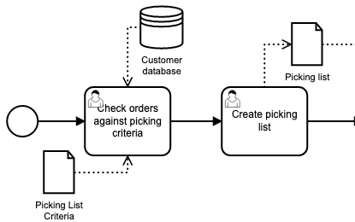
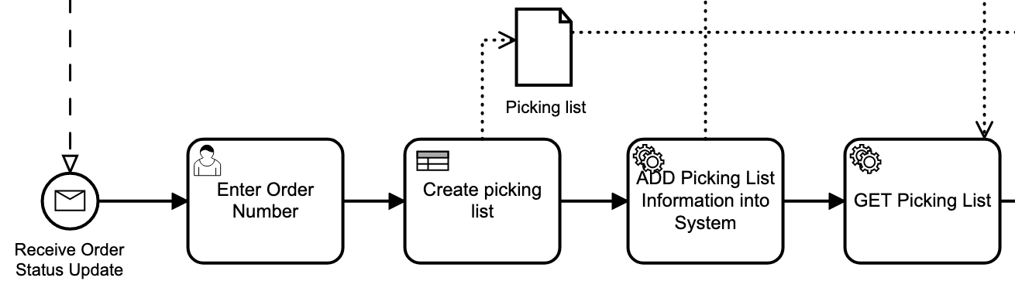
Automating User Tasks
To save time & money and increase efficiency we want to automate repetitive tasks
This will allow us to scale up our online business and sales
It will also reduce errors due to human oversight leading to higher customer satisfaction
Notes:
Where possible we want to automate user tasks with service tasks. This should not only lead to saving money and time but set us up to be more scalable as demand grows for our online business.
It will be more motivating for employees to not have to do menial repetitive tasks that are often error prone when carried out by humans and support them in carrying out their jobs more effiiciently
Reducing errors in our fulfilment process will also lead to higher customer satisfaction
In the picture on the top left you can see our current process for creating a picking list. Here an employee needs to check each order against the picking criteria and create the picking lists them self. In the future this will be automated and the employees can simply fgo pick the items based on the list which was automatically created from the implememntation of the business rule and service tasks as shown in. the picture on the right.

Slide 8
Adding a new DWH
To set ourselves up to the newest BI standards we want to opt for a DWH instead of separate DBs
The DWH will act as a single source of truth eliminating redundant data and mistakes
Opportunity to clean up our data structures to enhance data quality and consistency
It will enhance decision making due to better insights and allow for more confident forecasting
Notes:
Looking at todays best practices for data storage and BI we feel that a DWH would be the way to go forward. At the moment we store data in different data bases, having redundant data and not a clear policy which one is the single source of truth. This leads to mistakes as data is not always synchronicly updated.
Switching to a DWH will allow us to collect data in one place as the single source of truth eliminating redundant data and mistakes that may occur when data is updated in one database but not the other
By implementing a DWH it will serve as an opportunity to clean up our data structures to enhance data quality and consistency. This is a crucial step in order to up our BI giving us a competitive advantage by levereaging our operations and customer data to make informed decisions
It will also enable more confident forecasting for sales data and budgeting

Slide 9
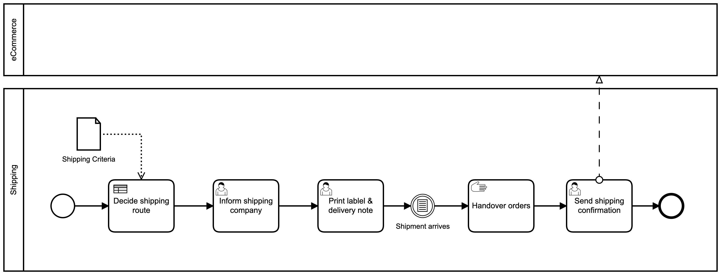
Outsourcing Shipping
As demand in the online business is increasing, we propose to outsource shipping to a third party provider who is an expert in this area
This will allow us to focus our resources into other areas
Notes:
We realised that instead of taking the time and effort to try and improve our shipping process it makes more sense to outsource this to a third party provider like Post or DHL which are already specialised in this area. They provide scalable business solutions which can easily be integrated into our business process. This allows us to realocate resources to other areas such as our fulfilment, DWH and new eRecycling process.
In terms of cost for the bottom line it is likely to come us cheaper to this than investing in upgrading and digitalising our own shipping process.

Slide 10


What do these changes achieve?
Automate manual processes saving time & money
Making our business model more scalable for increasing customer demand
Enable us to become more competitive with up to date technology and BI
Satisfying our customers needs for online retail vs offline
Making our business model more agile for unforseen challenges
Notes:
Innovationszyklen

Slide 11



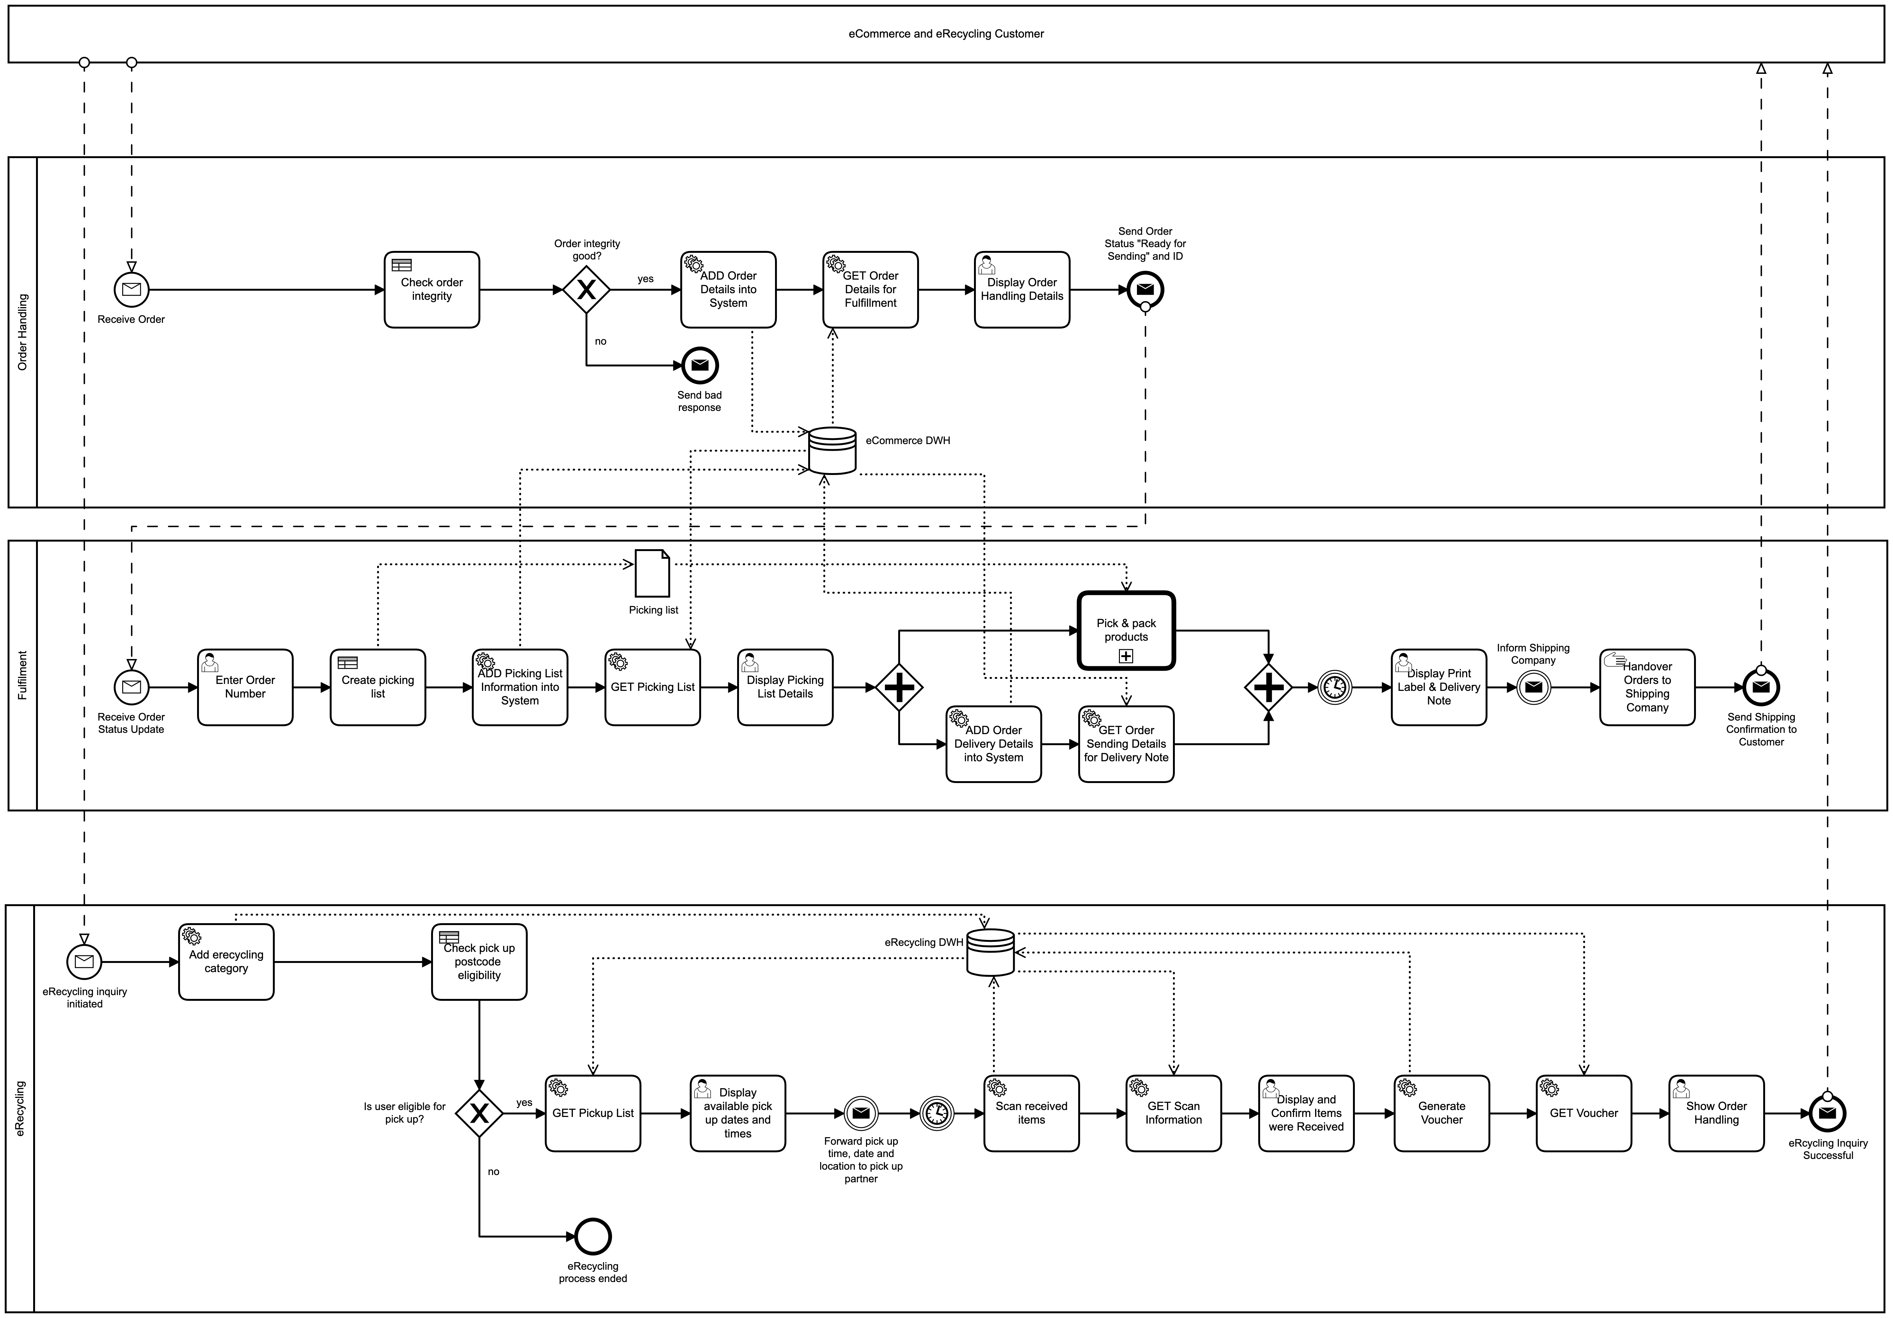


Customer Order
Hand over order to shipping partner dispatch
Delivery confirmation
Product delivery by the shipping partner
eRecycling inquiry
Product pick-up and delivery by Partner
Product return voucher
New Digital Business Opportunity

Slide 12
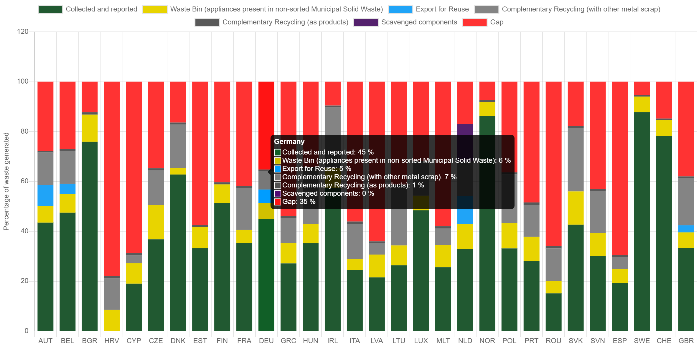
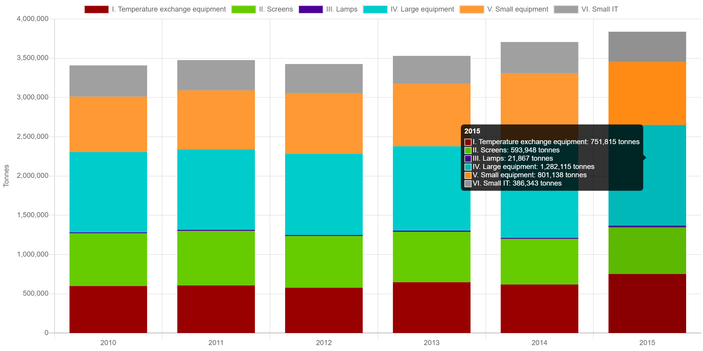
Why eRecycling?
Waste Electrical and Electronic Equipments (WEEE) is the fastest growing waste stream in the world.
Contribution to the environment through product collection. This has additionally a positive impact on the company's reputation
Collected EEE from waste generated in 2015
Closed-loop Product Data can be evaluated or directly resold
Data analysis has direct impact on product lifecycle and the management of that cycle
Data use for time series analyses and trend development calculation
Collected and reported EEE in EU
Notes:
http://www.urbanmineplatform.eu/homepage
https://www.sciencedirect.com/science/article/pii/S1878029616301499

Slide 13
eRecycling as Business Enrichment
Green certification
Profit maximization through synergy effect with the product order process
Reusing electronic waste
Strengthen customer loyalty
Product life cycle data collection
Notes:
Innovationszyklen

